Slide 1
Introduction
Proposal of an integrated system utilizing CCTV, deep learning, and YOLOv8 object detection for real-time hazard monitoring in challenging terrain regions.
Focus on accident, wildlife and flood with insights into algorithms and datasets used.
Multithreading enables quick hazard response, with an integrated alert system promptly notifying authorities.
Benefits include proactive hazard mitigation, precise resource allocation, ecosystem conservation, and improved infrastructure resilience.
Recognition of limitations and identification of future research opportunities in advanced detection technologies for safety in challenging terrain regions.

Slide 2
Objective(s)
• To Identify and Prevent Terrain-Related Incidents
• To Leverage Data to Improve Road Safety
• To Enhancing Transportation Infrastructure Resilience

Slide 3
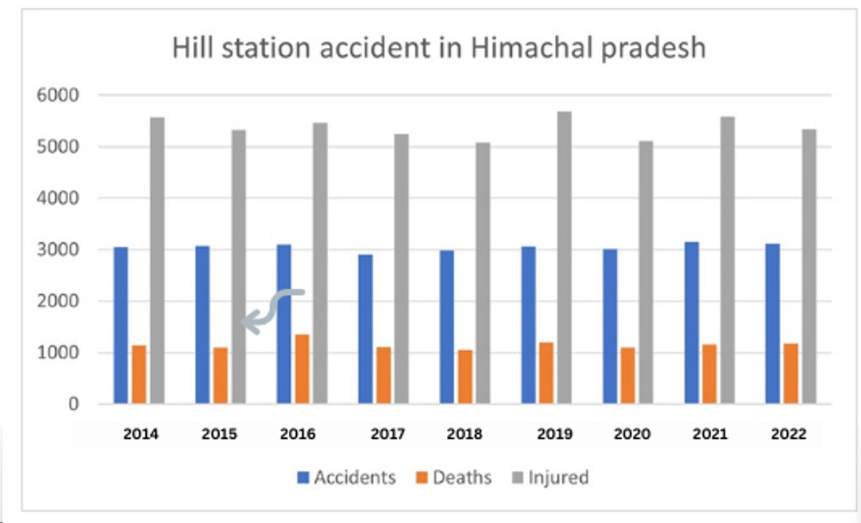
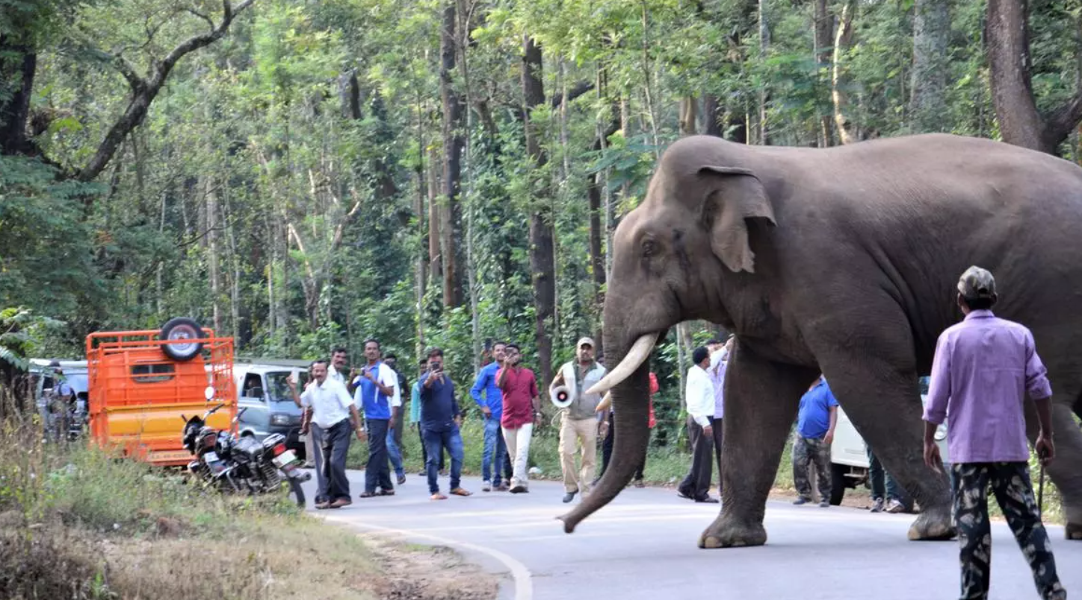
Motivation
To improve the safety of people and infrastructure in areas prone to natural hazards.
To reduce the environmental impact of human activity.
Himachal Pradesh witnessed around 3000 accidents every year

Slide 4
Literature Survey
AUTHORS | TITLE OF THE PAPER WITH YEAR | TECHNIQUE USED | PROS AND CONS
Mrs.Meera.S,Priyadharshini,P V Vardhitha, R. SaiCharitha | Animal Detection Alert System | YOLO & IOU | Pros:The systems effective in both day and night time. Cons:Only animals within 10 meter radius are detected.
Sanjay Santhanam,Sudhir Sidaarthan,Sai Sudha Panigrahi,Bhargav | Animal Detection for Road Safety using Deep Learning | YOLOv3 & LiDar Technology | Pros:The model gives 91% accuracy. Cons:The efficiency depends on how slow the vehicle moves in some situations.
Nopparut L,Worapan Kusakunniran,Seiji Hotta | Detection of Animal Behind Cage Using Convolutional neural Network | CNN-M2DET Model | Pros:The accuracy is 88% Cons:The model is designed to only two types of animals

Slide 5
Literature Survey
Matthew Moy de Vitry, Simon Kramer, Jan Dirk Wegner, João P. Leitão | Scalable Flood Level Trend Monitoring with Surveillance Cameras using a Deep Convolutional Neural Network | DCNN SOFI | Pros:Correlation with Water Level Trends Cons: Noisy Signals
Nivali Yadav, UmeshThakur, Akanksha Poonia, Rajeevan Chandel | Post Crash Detection and Traffic Analysis | YOLO v5 | Pros: Took only 0.5s to analyze an image. Cons:The Quickness of the model Depend on the GPU is used.
Kyu Beom Lee, Hyu Soung Shin | An application of a deep learning algorithm for automatic detection of unexpected accidents under bad CCTV monitoring conditions in tunnels | Faster RCNN, ODTS | Pros: possible to detect the accidents within 10 seconds. Cons: Discrepancies in object detection performance, potential false detections
18/03/2024
Project Review

Slide 6
Literature Survey
Sreedevi K L,Dr Anitha Edison | Wild Animal Detection using Deep Learning | Depth-wise separable convolution & IOU | Pros:99.6% accuracy for classification of wild Animal. Cons:The number of images that used to train is low
Amrutha H M, Naresh E, Prashanth Kambli Dayananda P and Niranjanamurthy M | Identification of Harmful animal detection using Image Processing Technique | YOLO | Pros: The Actual interval item discovery YOLO system is period effective. Cons:the Quickness of the model Depend on the GPU is used.
T. Rajendran, Abdul Kareem. D, Mohamed Imtiaz. N and Jagadeesh. K | Road Obstacles Detection using Convolution Neural Network and Report using IoT | Conventional Neural Networks, Median filter, canny edge detection, OTSU threshold. | Pros: The approach of classifying the negative obstacles Cons: The communications between the camera and ESP sensors are highly reliable.

Slide 7
Literature Survey
Husnu Baris Baydargil, Serkan Serdaroglu, Jang-Sik Park, Kwang-Hee Park | Flood Detection and Control Using Deep Convolutional Encoder-decoder Architecture | Image segmentation, | Pros:High accuracy of 88% Cons: Need for More Thorough Training
Samira Pouyanfar , Yudong Tao , Saad Sadiq , Haiman Tian , Yuexuan Tu | Unconstrained flood event detection using adversarial data augmentation | style transfer, generative adversarial networks | Pros: CycleGAN is employed as part of the proposed data augmentation to transfer various styles Cons: the number of non-flood images can be increased to evaluate
Vineeth V, Dr. Neeba E A | Flood Detection using Deep LearningI | CNN. Mask Region Based CNN (MRCNN). | Pros:The accuracy of 94 with 50 epoch Cons: Future improvements are needed.

Slide 8
Issues in Existing system
The efficiency depends on how slow the vehicle moves in some situations.
The effectiveness of deep learning models heavily relies on the quality and diversity of the training data.
Usability Issues: Poor user interface design.
Poor Error Handling: Inadequate error handling mechanisms that fail to gracefully handle unexpected situations, leading to system failures or incorrect behavior.

Slide 9
Proposed System
Integration of YOLOv8, a fast and accurate object detection algorithm, focusing on
instance segmentation for flood detection.
Utilization of CSPDarknet53, PANet, and a YOLO head for precise detection of
accidents, road obstacles, and wildlife in terrain environments.
Instance segmentation provides pixel-level delineation for flood-affected areas,
enhancing detailed object understanding.
Real-time monitoring of CCTV feeds triggers immediate alerts for emergency response or flood management.
Visualized and analyzed data informs decision-making, ensuring optimal performance through continuous maintenance.
Enhanced safety and community resilience achieved by enabling rapid hazard detection and accurate categorization.
Provision of data-driven insights for effective decision-making processes.
Future work may involve refining models and expanding capabilities for broader terrain safety applications, further benefiting community well-being.

Slide 10
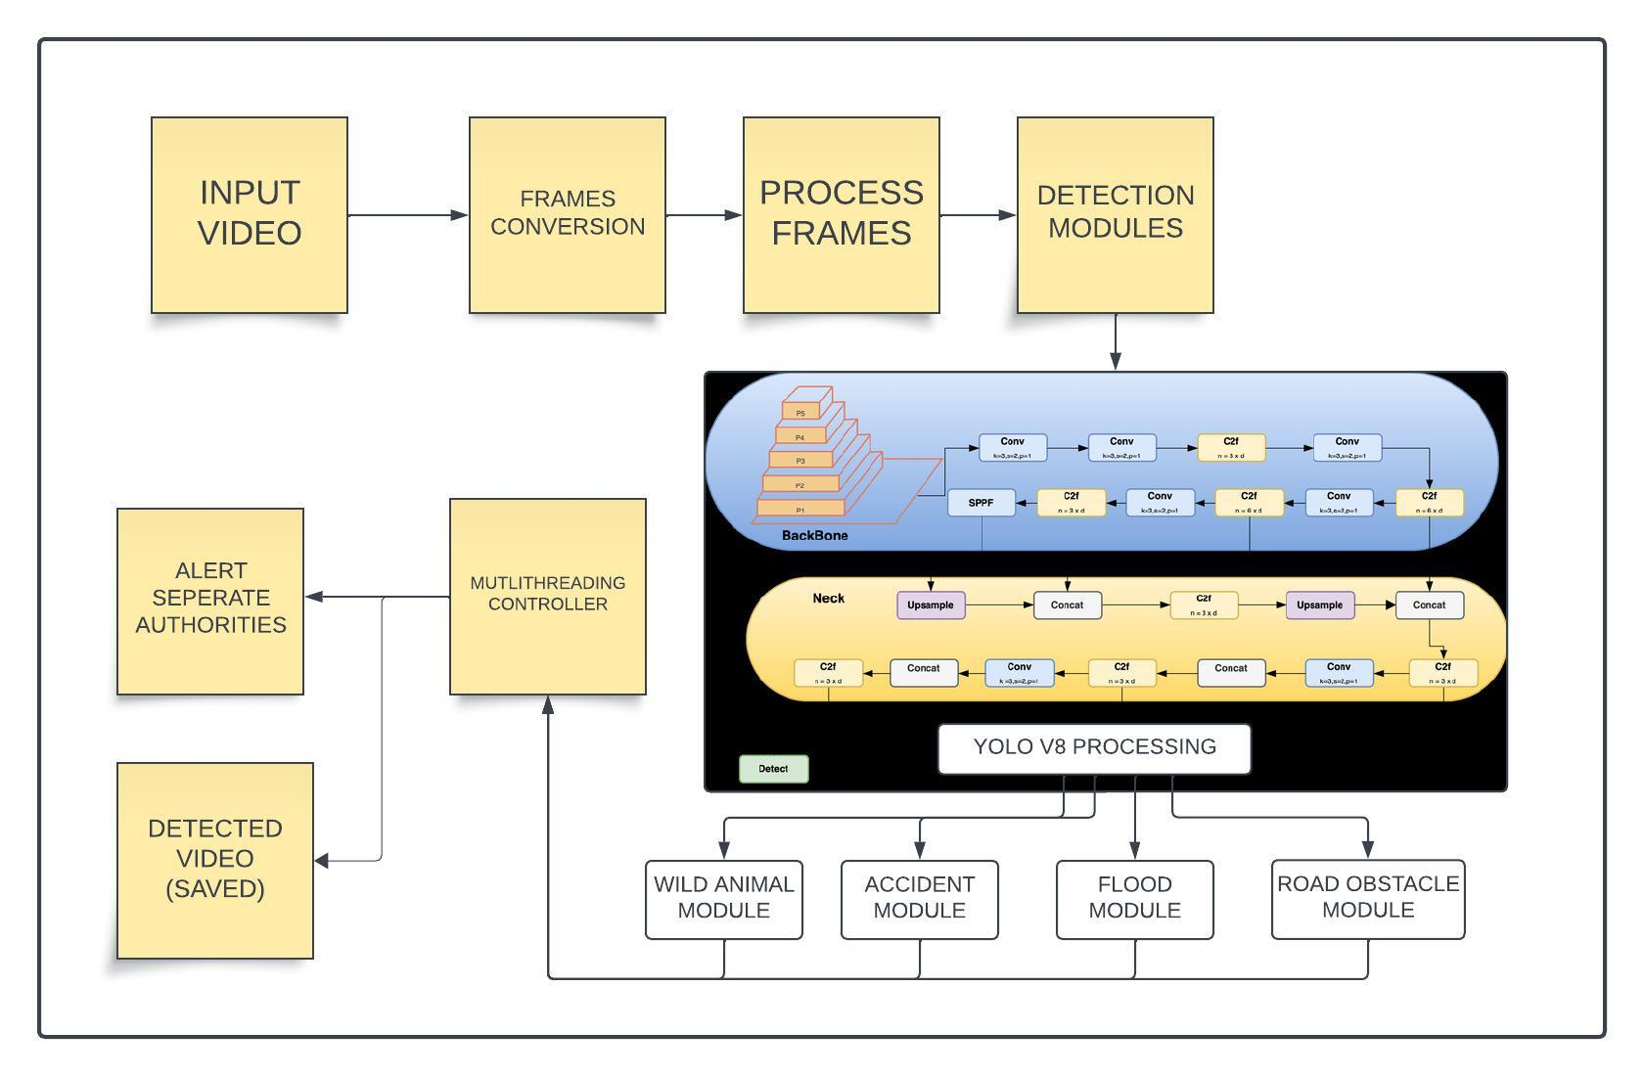
Architecture Diagram
Animal Detection Processing
10

Slide 11
List of modules
Accident detection
Wild animal detection
Flood detection
Multithreading and Integrating

Slide 12
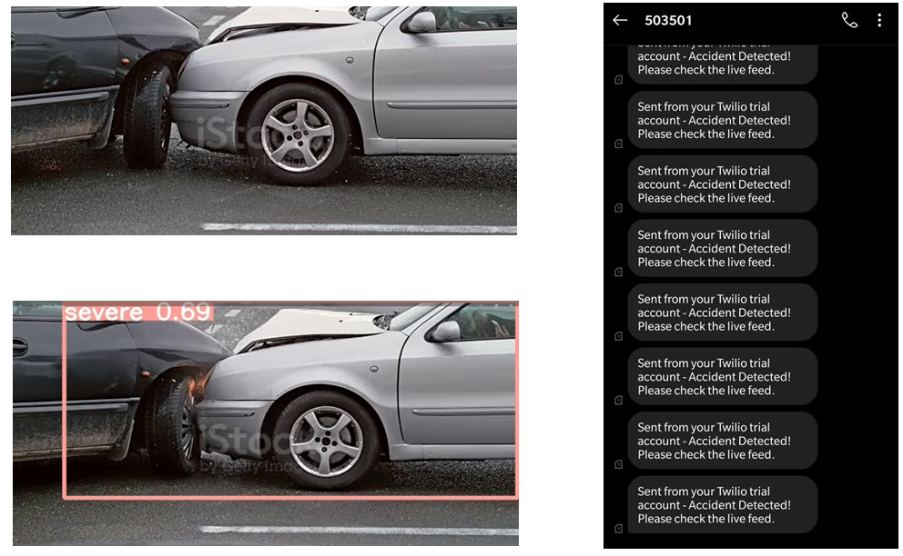
Module 1: Accident Detection
12

Slide 13
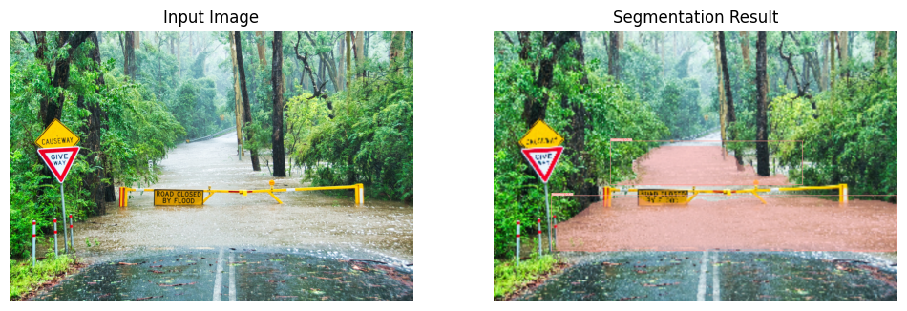
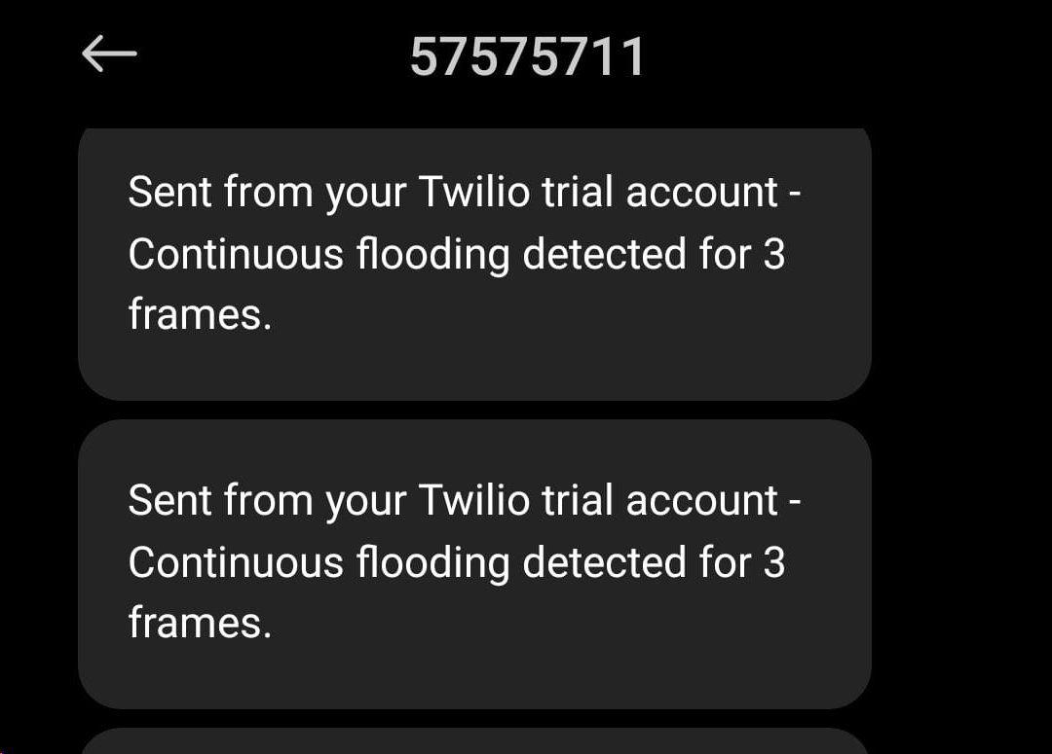
Module 2 :Flood Detection
13

Slide 14
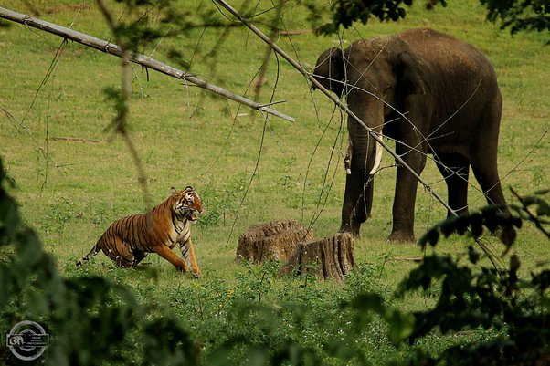
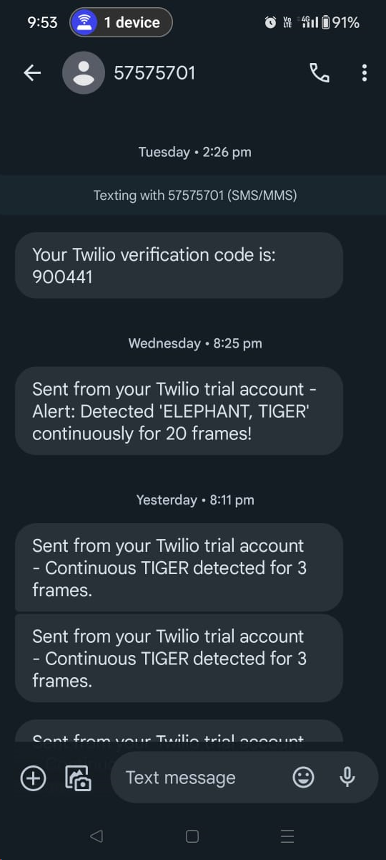
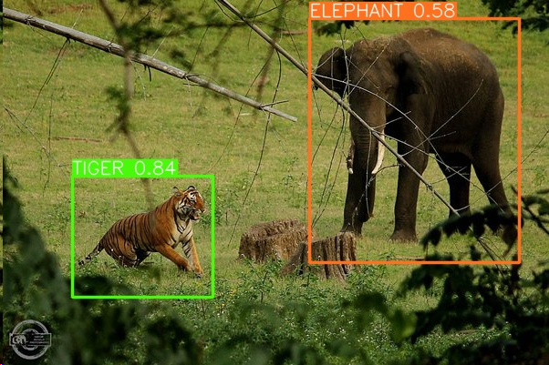
Module 3 : Animal Detection

Slide 15
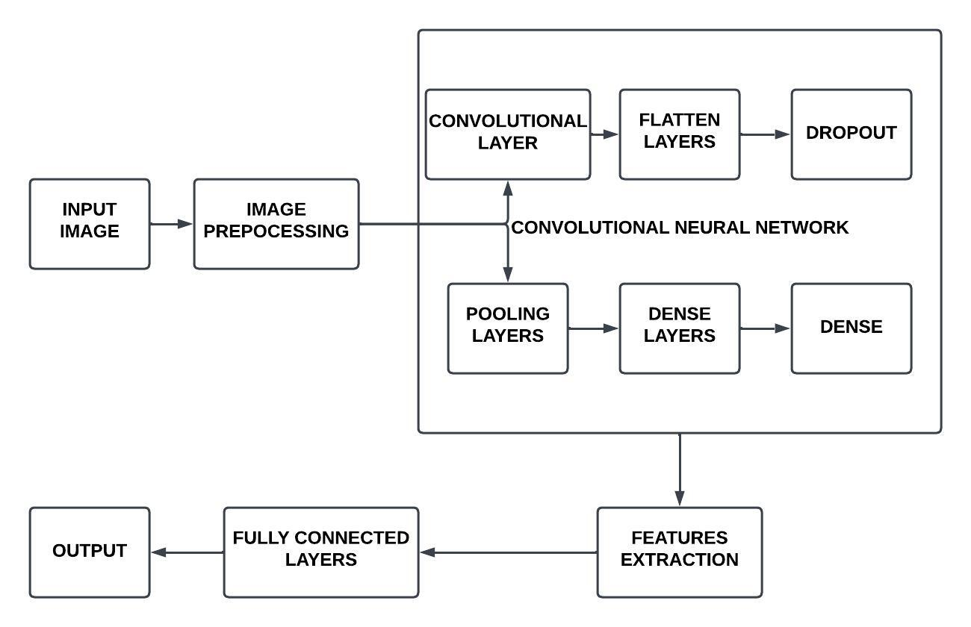
Functional Architecture
Animal Detection Processing
15

Slide 16
Algorithm Used
YOLO v8 (You Only Look Once).
Twilio API.
OpenCV (Open Source Computer Vision Library).
PyTorch.

Slide 17
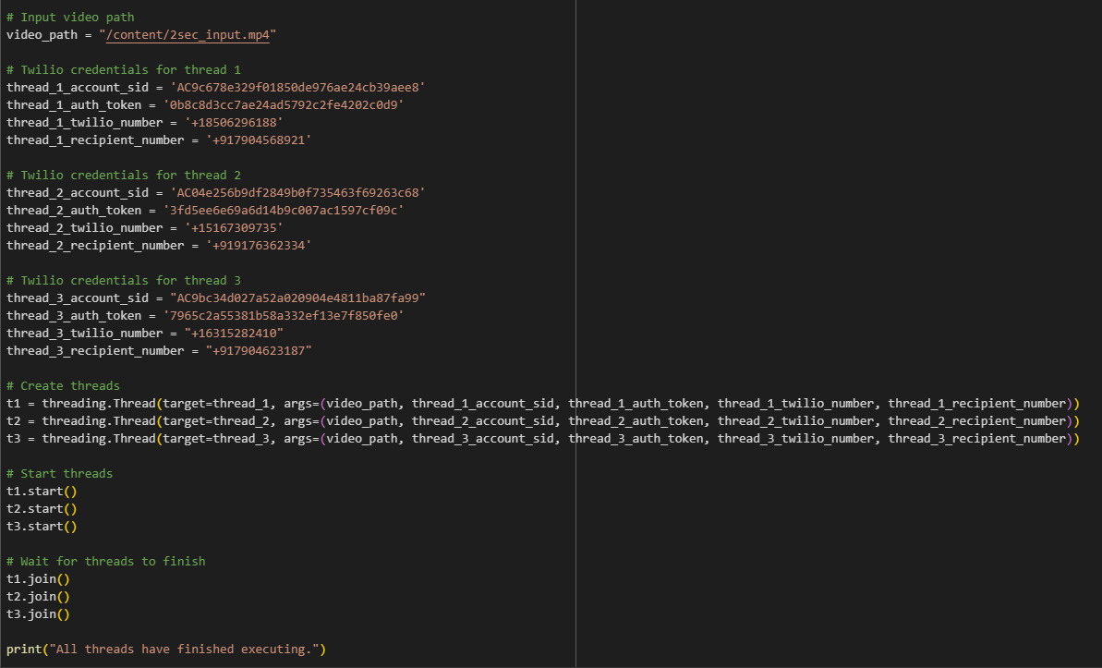
Implementation

Slide 18
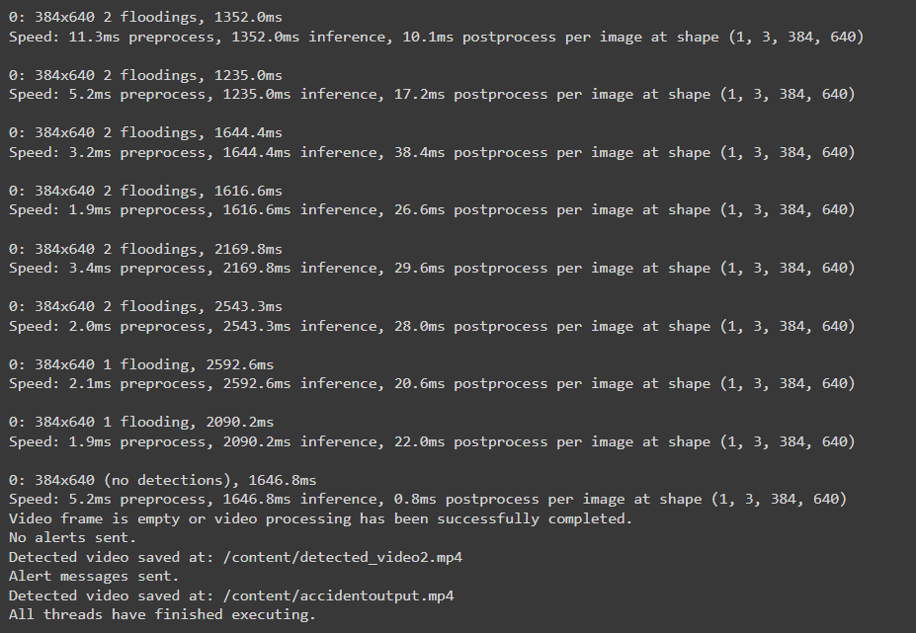
Implementation

Slide 19
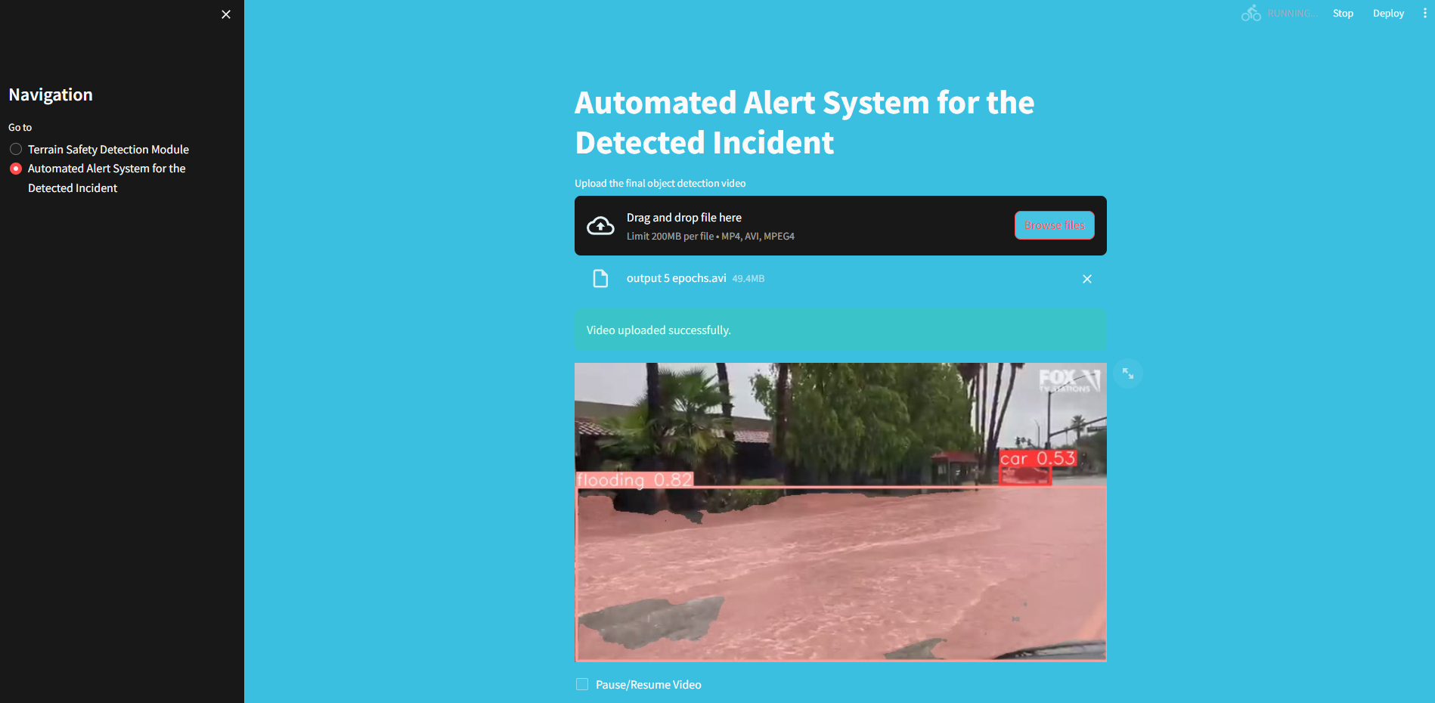
Implementation

Slide 20
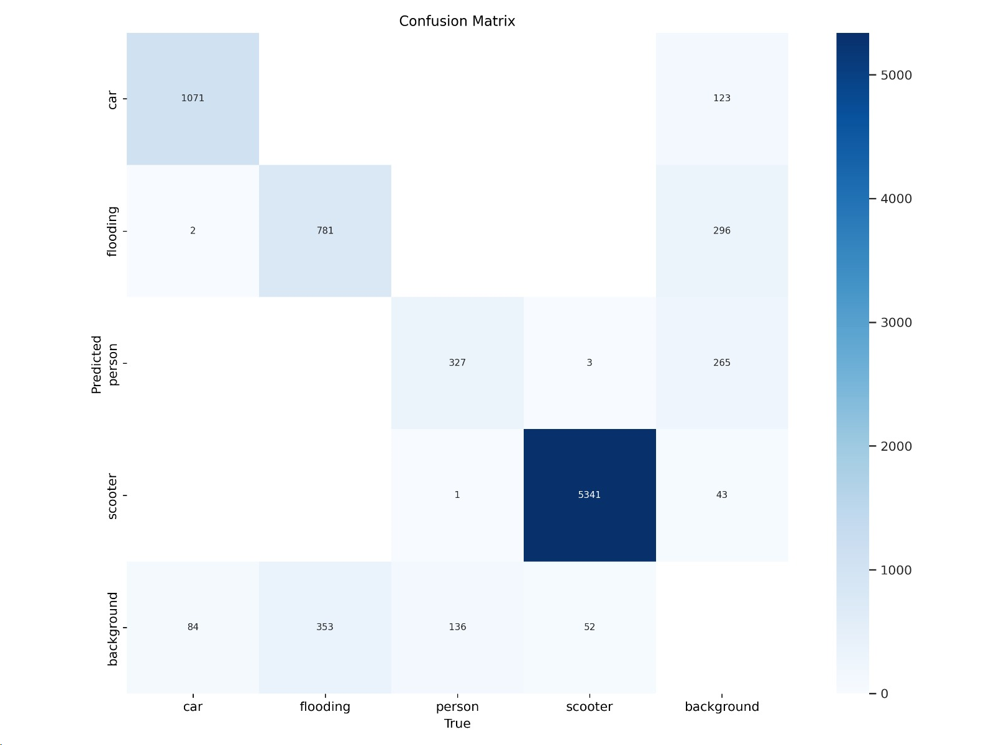
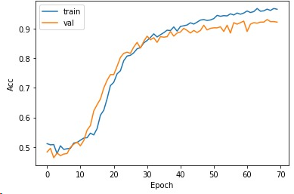
Performance Evaluation
Flood Accuracy Curve
18/03/2024
Project Review

Slide 21
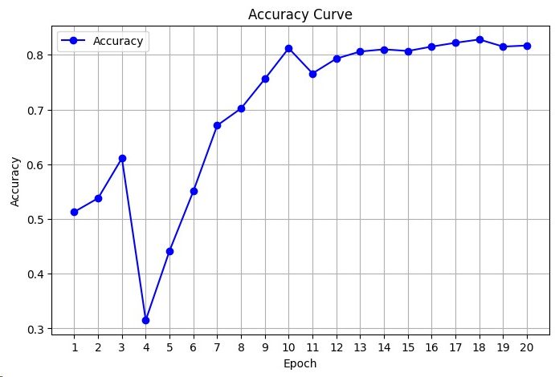
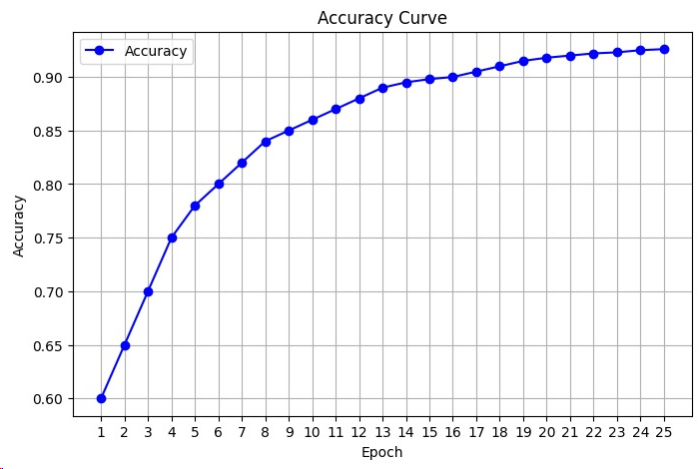
Performance Evaluation
Animal Accuracy Curve
Accident Accuracy Curve
18/03/2024
Project Review

Slide 22
Test cases
Testcase ID | Total Score from Assessment | Actual Result | Expected Result | Pass/Fail
1 | 0.69 | Severe and Alert is Triggered | Severe and Alert Should be Triggered | Pass
2 | 0.84 | Tiger and Elephant are Detected | Tiger and Elephant should be Detected | Pass
3 | 0.86 | Flooding , Car and Person are Detected | Flooding Should be Detected | Pass
4 | 0.36 | Detected a Tree as a Tiger | No Detection Should be Detected | Fail
5 | 0.32 | Detected Pond as a Flooding | No Flooding should be Detected | Fail

Slide 23
System Requirements
SOFTWARE :
Python Environment: Python 3.x installed with necessary packages like NumPy, OpenCV, and imutils for image processing tasks. Anaconda distribution can simplify package management.
Integrated Development Environment (IDE): Use of IDEs like Google Colab or Jupyter Notebook for code development and experimentation.
HARDWARE :
Processor: A multi-core processor (e.g., Intel Core i5 or higher) to handle the computational load efficiently.
Memory(RAM): At least 8 GB of RAM to accommodate image processing operations and data manipulation.
TECHNOLOGY USED : Python with OpenCV Deep Learning Frameworks.

Slide 24
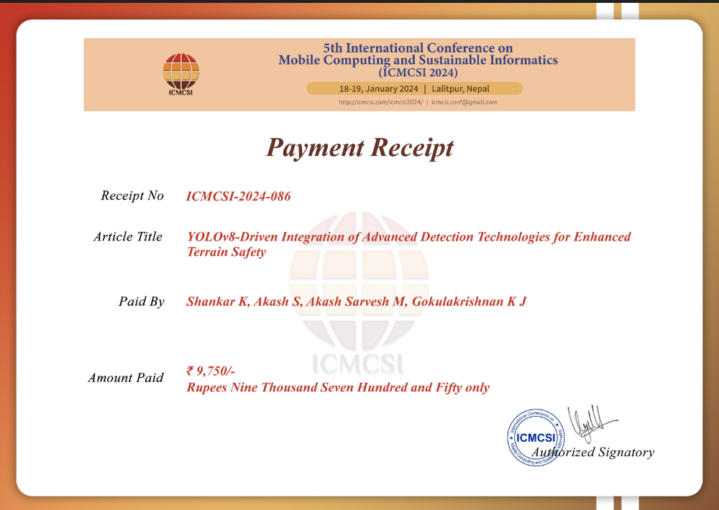
List of Publications
Submitted in ICMCST-24 conference , Publisher: IEEE

Slide 25
References
Babu, R., & Rajitha, B. (2022, July). Accident Detection through CCTV Surveillance. In 2022 IEEE Students Conference on Engineering and Systems (SCES) (pp. 01-06). IEEE. ​
Lee, K. B., & Shin, H. S. (2019, August). An application of a deep learning algorithm for automatic detection of unexpected accidents under bad CCTV monitoring conditions in tunnels. In 2019 International Conference on deep learning and machine learning in emerging applications (Deep-ML) (pp. 7-11). IEEE.​
Yadav, N., Thakur, U., Poonia, A., & Chandel, R. (2021, August). Post-Crash Detection and Traffic Analysis. In 2021 8th International Conference on Signal Processing and Integrated Networks (SPIN) (pp. 1092-1097). IEEE.​
Meera, S., Priyadharshini, K., Varshitha, P. V., & SaiCharitha, R. (2022, November). Animal Detection Alert System. In 2022 1st International Conference on Computational Science and Technology (ICCST) (pp. 538-542). IEEE.​
Santhanam, S., Panigrahi, S. S., Kashyap, S. K., & Duriseti, B. K. (2021, November). Animal Detection for Road safety using Deep Learning. In 2021 International Conference on Computational Intelligence and Computing Applications (ICCICA) (pp. 1-5). IEEE.​
25

Slide 26
References
Li, N., Kusakunniran, W., & Hotta, S. (2020, June). Detection of Animal Behind Cages Using Convolutional Neural Network. In 2020 17th International Conference on Electrical Engineering/Electronics, Computer, Telecommunications and Information Technology (ECTI-CON) (pp. 242-245). IEEE.
Sharma, S., Shah, D., Bhavsar, R., Jaiswal, B., & Bamniya, K. (2014, January). Automated detection of animals in context to indian scenario. In 2014 5th International Conference on Intelligent Systems, Modelling and Simulation (pp. 334-338). IEEE.
Amrutha, H. M., Naresh, E., Kambli, P., Dayananda, P., & Niranjanamurthy, M. (2022, December). Identification of Harmful animal detection using Image Processing Technique. In 2022 Fourth International Conference on Cognitive Computing and Information Processing (CCIP) (pp. 1-5). IEEE.
Bandari G., Devi, L. N., & Srividya, P. (2022, December). Wild Animal Detection using a Machine Learning Approach and Alerting using LoRa Communication. In 2022 International Conference on Smart Generation Computing, Communication and Networking (SMART GENCON) (pp. 1-5). IEEE.
Sreedevi K L , Anitha Edison. Wild Animal Detection using Deep Learning Approach and Alerting using LoRa Communication. In 2022 International Conference on Smart Generation Computing, Communication and Networking (pp. 1-5). IEEE.
26

Slide 27
References
Peramo, E., Aborot, J., Bensig, J. R., Deiparine, P. J., Flores, S. M., Gumera, C., & de Leon, F. A. (2022, November). Intelligent Flood Detection using Traffic Surveillance Images based on Convolutional Neural Network and Image Parsing. In 2022 IEEE International Conference on Computing (ICOCO) (pp. 220-225). IEEE.
Baydargil, H. B., Serdaroglu, S., Park, J. S., Park, K. H., & Shin, H. S. (2018, September). Flood detection and control using deep convolutional encoder-decoder architecture. In 2018 International conference on information and communication technology robotics (ICT-ROBOT) (pp. 1-3). IEEE.
Dr. Neeba E A. Flood Detection and Depth Estimation Using Deep Learning, digital elevation models, and machine learning algorithms. Remote Sensing, 14(3), 440.
Samira Pouyanfar and her team (2019, September). Unconstrained flood event detection using adversarial data augmentation. In 2019 IEEE International Conference on Image Processing (ICIP) (pp. 155-159). IEEE.
27

Slide 28
Thank You
28

